Slide 1



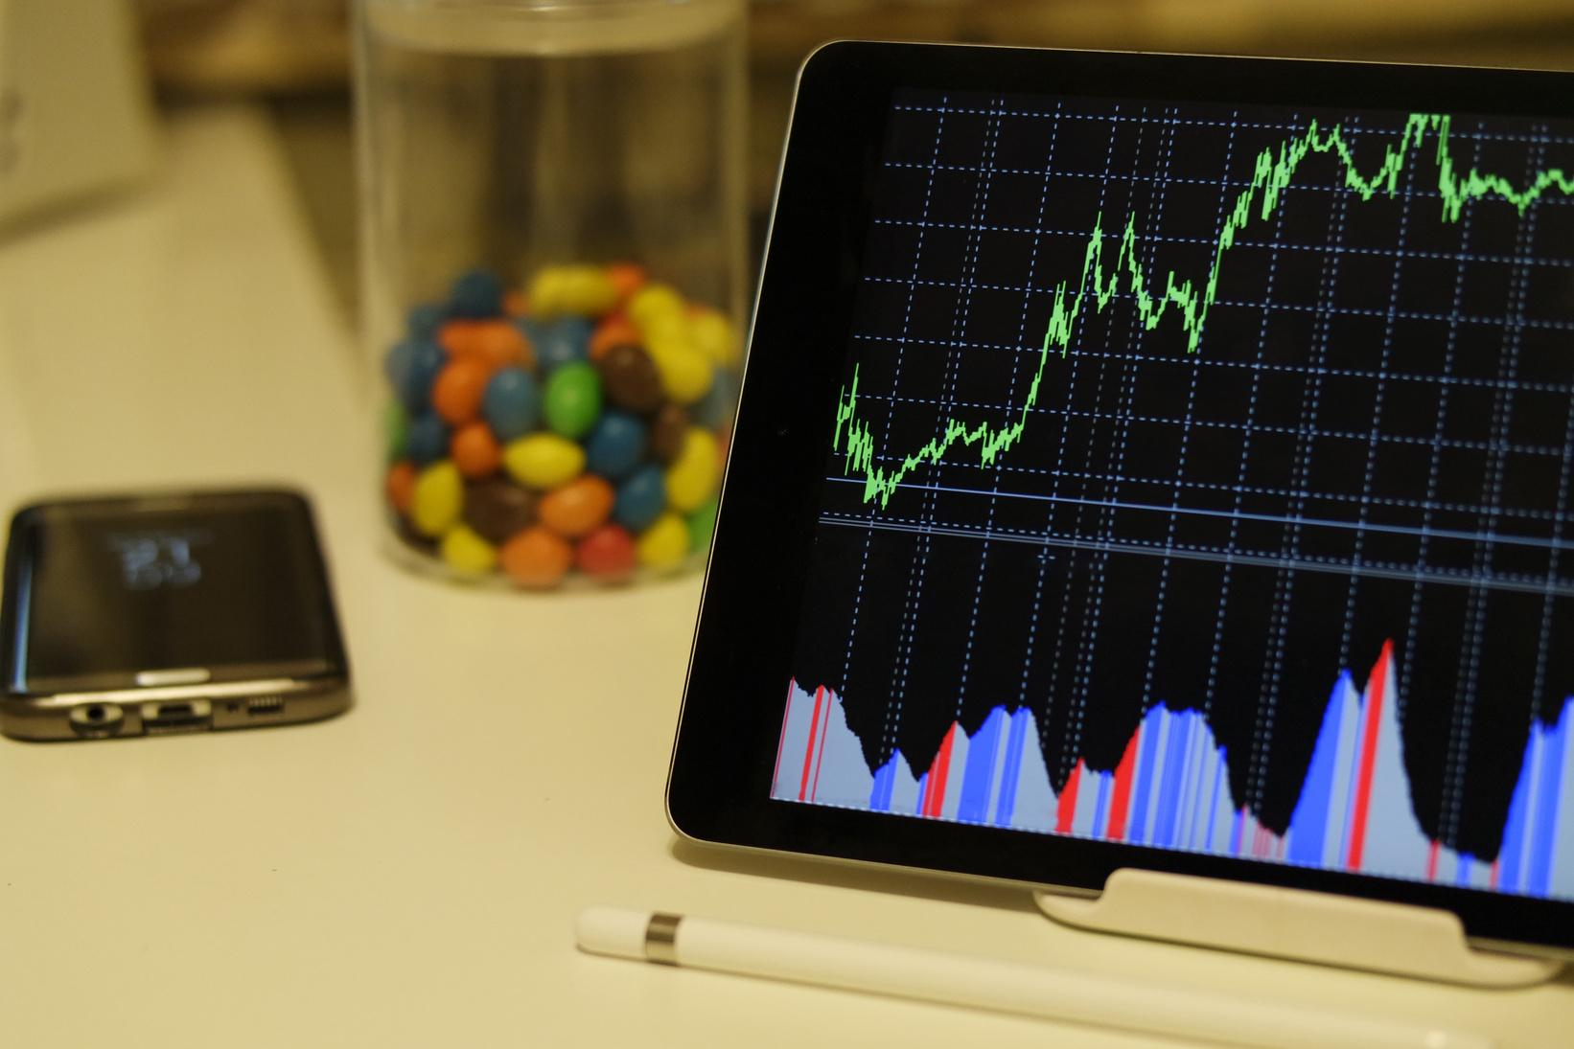

Data Source: Kaggle
Final
Project
Presentation
Group 8
Argel Perez
Stefani Wilson

Slide 2


Business Problem
The Main Question and Problem
Standard stats don’t always show who has the most efficiency on the court.
How many points does a player contribute for every 10 minutes of play time?
Relevance to Business Decision Making
It helps coaches and managers to decide who to invest more playing time in.
DataSet Summary
Analyzed 1,628 (players)
36 Columns(Stat categories)
Player
Position
Team
Mpg_minutes_per_game
Ppg_points_per_game

Slide 3

Data Cleaning Highlights
Missing Values
We chose to fill missing values with 0 instead of dropping rows because many of the missing values are basketball statistics. If a player was missing a stat from one of the CSV files, we treated it as 0 so we could keep the player in the dataset
Fixing and Cleaning Data Types
Converted ppg and mpg from string to floats to be able to complete the points per 10 minutes calculation
Assigned Team and position as categorical data types to help with better visualization

Slide 4

Exploratory
Analysis
We reviewed player stats such as points, minutes, team, and position.
We cleaned the data by fixing column names and filling missing values with 0.
We created a new column called points_per_10_minutes.
Formula: points per game ÷ minutes per game × 10
This helps compare players fairly, even if they play different minutes.

Slide 5
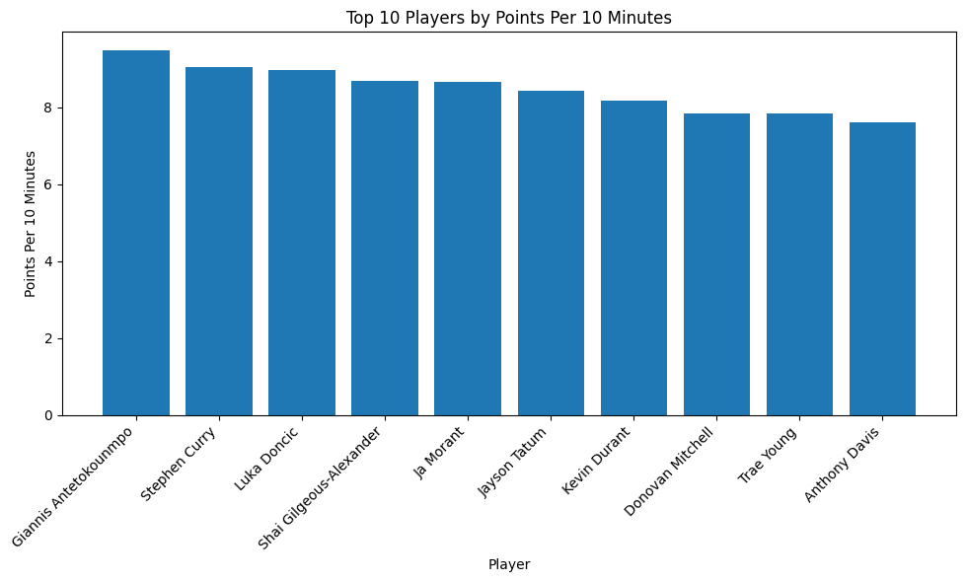
Bar Chart
Top 10 Players by Points per 10 Minutes
The comparison of players average points scored in 10 minutes
The Top 10 Player average scoring efficiency per 10 minutes is between 8 and 8.7 points
This helps the coaches and managers see who their strongest scorers are and who to give more playing time.
(Matplotlib)

Slide 6
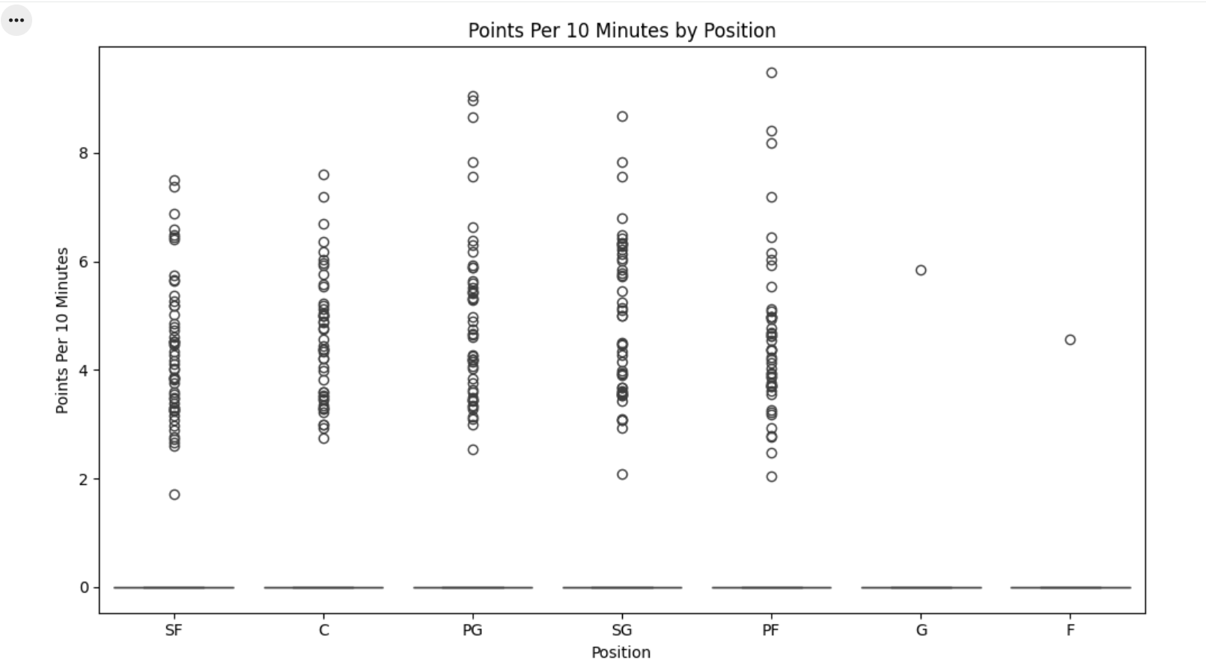
Boxplot
Points Per 10 Minutes by Position
Compares scoring efficiency across positions.
Most positions have players scoring between about 2–6 points per 10 minutes.
Some players are outliers, scoring much higher than others.
This helps coaches see which positions have the widest range of scoring efficiency.
(Seaborn)

Slide 7

Key Insights
Efficient scoring matters
Points per 10 minutes compares players fairly.
points_per_10_minutes gives a fairer comparison than points per game alone.
Some players may be efficient scorers even if they do not play many minutes.
Coaches can use this information to decide which players may deserve more playing time.
Position comparisons help show where scoring efficiency is strongest.
Minutes do not tell the full story
Some players score well with limited playing time.
Position trends are useful
The boxplot shows scoring differences by position.
Coaching decision support
Coaches can use this to identify players who may deserve more minutes.

Slide 8

Conclusion
Limitations:
Missing values were filled with 0, which may affect some results.
The data only shows stats, not injuries, matchups, defense, or coaching strategy.
Conclusion:
This analysis helps identify efficient scorers based on playing time.
Coaches can use points per 10 minutes as one tool when making playing-time decisions.

